Slide 1

Drive Trains
The Bionic Tigers - 10464

Slide 2
Considerations when choosing
Speed
How fast do you want to go?
Power
Maneuverability
Traction
Terrain
Omni-directional

Slide 3
4 Wheel
6 Wheel
Mecanum
X-Drive
H-Drive
Treads
Swerve Drive
Drivetrain Types
The most common drivetrain configurations in FTC

Slide 4
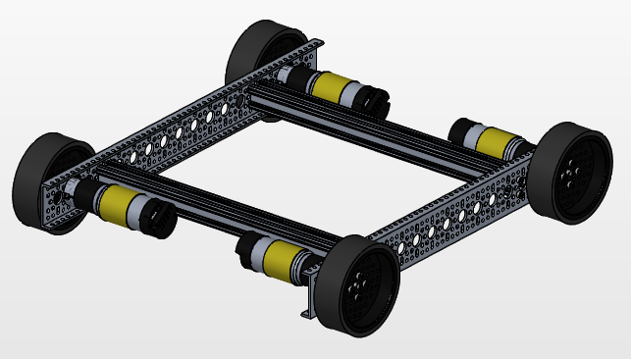
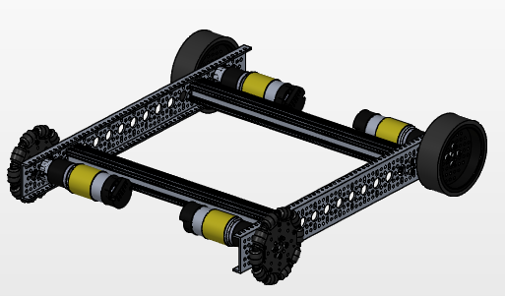
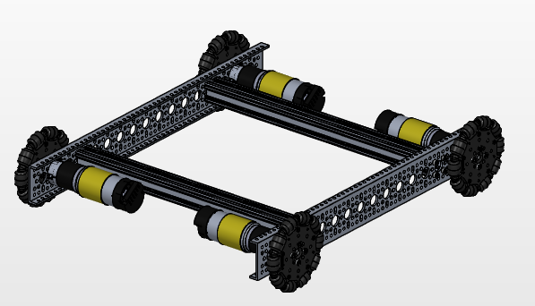
4 Wheel
4 Traction Wheels
Good Traction
Poor Maneuverability
2 Traction 2 Omni
Off-Center Rotation
Good traction
Good Maneuverability
4 Omni Wheels
Good Maneuverability
Poor Traction
4 Traction
2 Traction
2 omni
4 omni

Slide 5
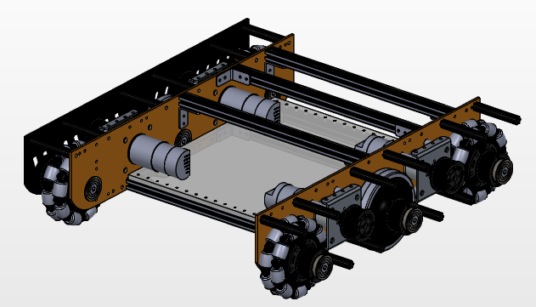
6 Wheel
High Traction
Good Maneuverability
Versatile Terrain
Can’t strafe
4 omni 2 traction

Slide 6
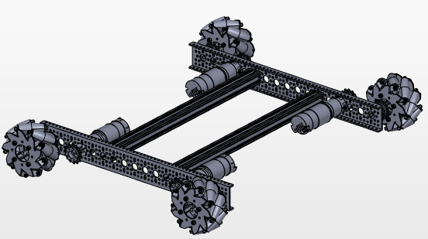
Mecanum
High Maneuverability
Good Traction
Strafing
Best on flat field
Requires exact measurements for best application

Slide 7
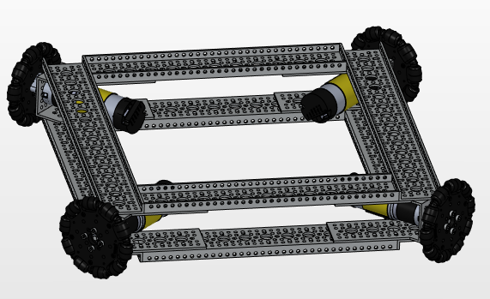
X-Drive
High Maneuverability
Poor Traction
Strafing
Unorthodox Motor Placement
Static Buildup

Slide 8
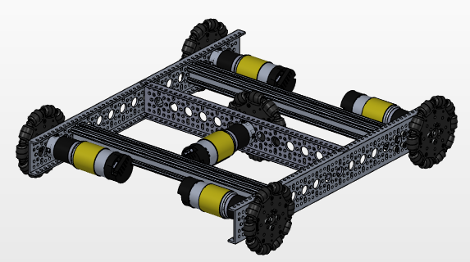
H-Drive
High maneuverability
Strafing
Poor traction
Space and motor consuming
Static Buildup

Slide 9
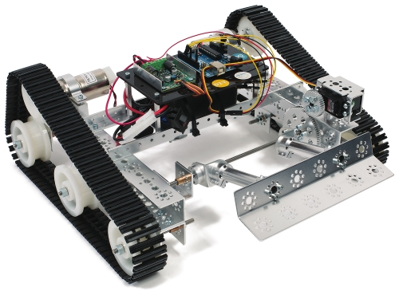
Treads
Good traction
Versatile Terrain
Poor maneuverability
Prone to breaking

Slide 10
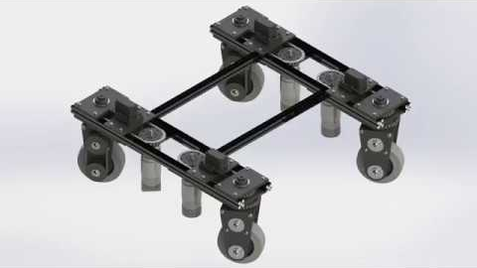
Swerve
High maneuverability
Good traction
Complex programming
Space consuming
Complex design

Slide 11
Drive Methods
How to get from motor to wheel
Direct Drive
Chain Drive
Belt Drive
Gear Drive

Slide 12
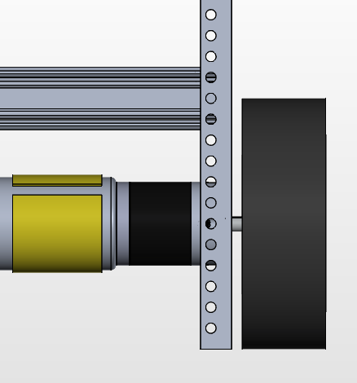
Direct Drive
Motor and wheel share the same shaft
Fewer points of failure
No flexibility in motor position
Wears down motor gearbox

Slide 13
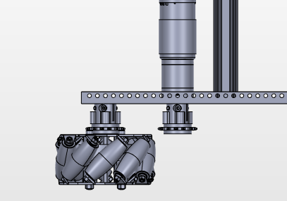
Chain Drive
Flexible motor positioning
Variable gear ratio
Adjustable length
Requires tension
Multiple points of failure

Slide 14
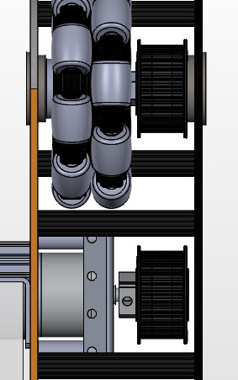
Belt Drive
Flexible motor position
Low maintenance
Variable gear ratio
Relatively few points of failure
Requires precise positioning
Requires tension

Slide 15
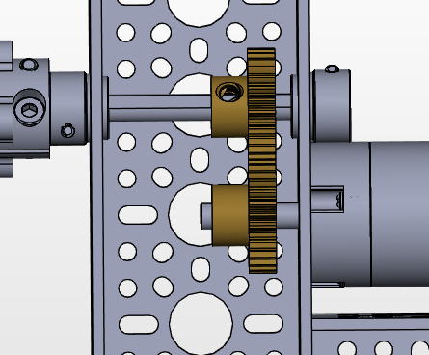
Gear Drive
Semi-flexible motor position
Variable gear ratio
Can slip and grind
Multiple points of failure

Slide 16
Tips and Tricks
Advice based on our own learnings
Take advantage of D shaped and hex shafts
Use consistent structure such as channel pieces
CAD and prototype before making complicated assemblies
Plan your drivetrain to accommodate the other mechanisms on your robot

Slide 17
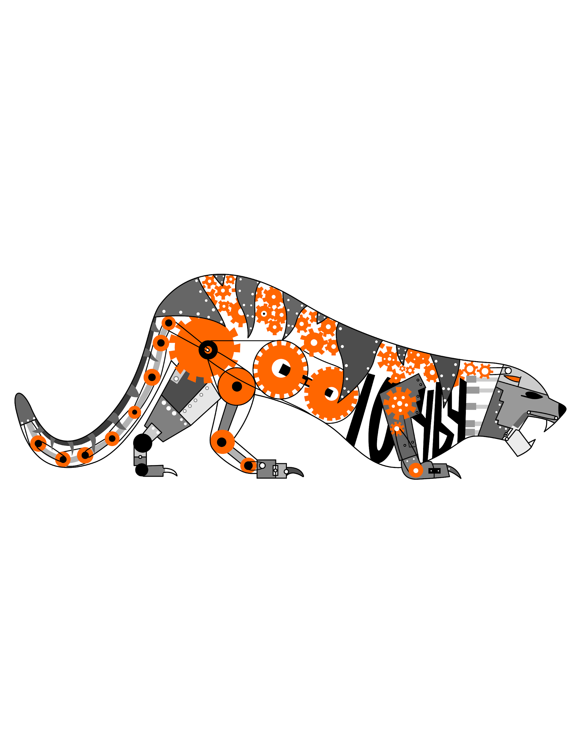
Credits
This lesson was written by The Bionic Tigers 10464 for FTCTutorials.com
You can contact the author at
More lessons for FIRST Tech Challenge are available at www.FTCtutorials.com
Website:
http://lovelandrobotics.com/team10464
Twitter:
@BionicTigersFTC
Email:
BionicTigers10464@gmail.com
This work is licensed under a
Creative Commons Attribution-NonCommercial-ShareAlike 4.0 International License.
Copyright 2020 FTCTutorials.com (Last edit 4/1/2020)

